Slide 1
How to Master Git and GitHub
at StarWest
October 4, 2016
by @WilsonMar
Skype: wilsonmar4
https://wilsonmar.github.io

Slide 2

About Wilson Mar
Wilson Mar has been building and bringing enterprise applications to market on major platforms—from mobile to server clouds—as an architect, developer, performance tester, and manager. His website wilsonmar.github.io provides concise, in-depth advice on leading technologies, especially on LoadRunner and performance engineering.
by @WilsonMar
Skype: wilsonmar4
https://linkedin.com/in/wilsonmar

Slide 3
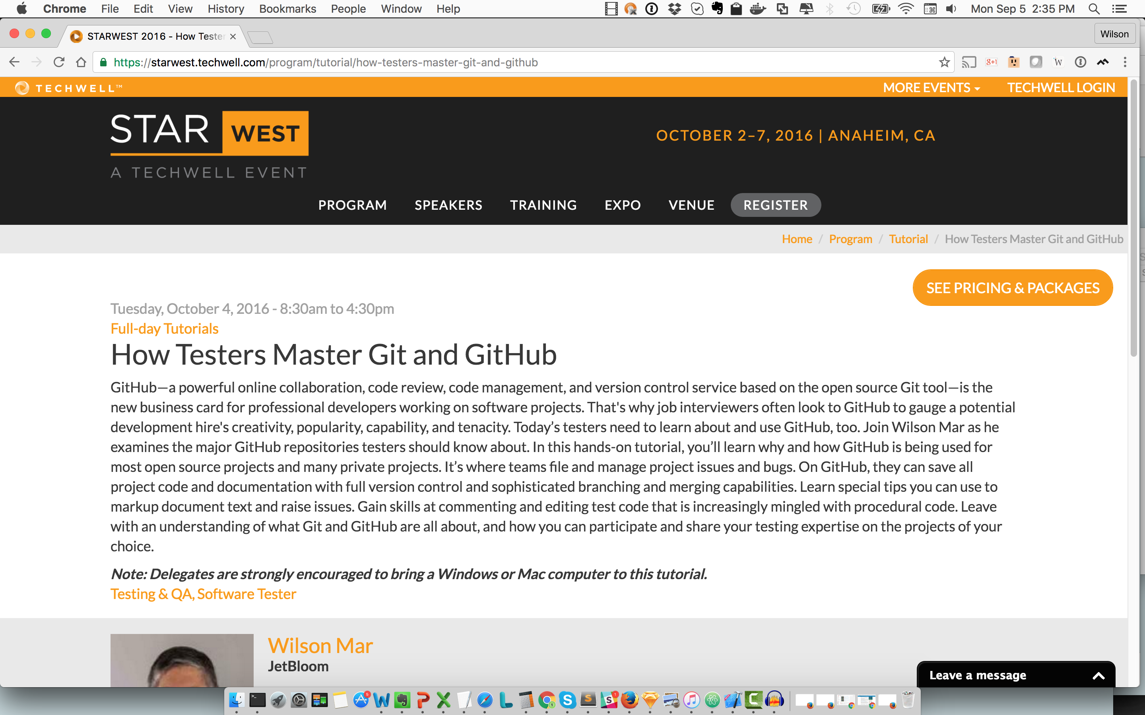

Slide 4
Learning techniques
Meticulously sequenced deep learning
Animated diagrams in PowerPoint (visual cheat sheets)
Narrated videos reveal animations
Runnable scripts of commands in sequence
Step-by-step hands-on commentary
Quizzes
Social sites and references to statistics
Notes:
Here is what my two years have created for your. What diffentiates

Slide 5
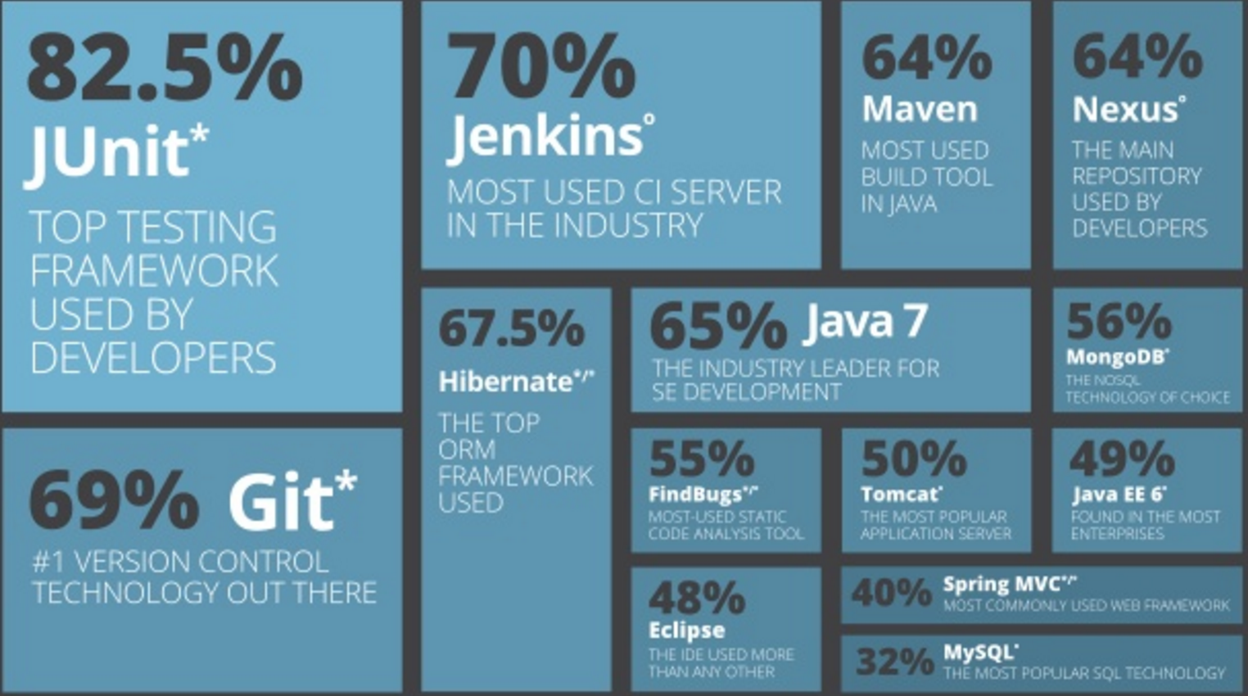
Java tools popularity
http://zeroturnaround.com/rebellabs/java-tools-and-technologies-landscape-for-2014/

Slide 6
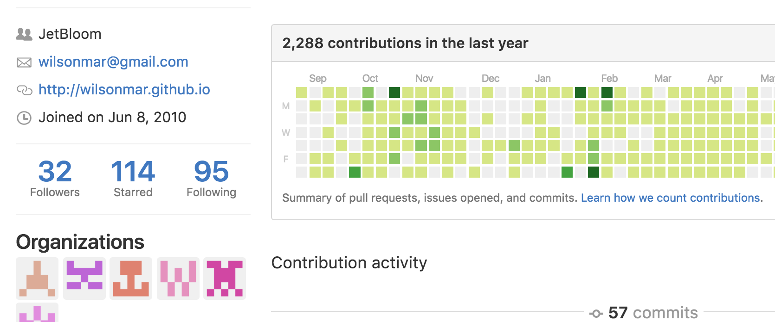
GitHub user statistics
newbie?
tenacious?
popular?
respected?
creative?

Slide 7
GitHub File Handling
Finder or Windows Explorer
IDE/app
compare (diff)
client
your rep (on
GitHub .com)
Local repo.
your GitHub .com or hosted
repo
your GitHub .com or hosted
repo
app default
external copies
history
folder
folder
zip/ copy
folder
manual copy
file
file
file
Edit
local
machine
Download
Fork
Downloads folder
GitHub.com repo
unzip
repo-master.zip
upstream
@Copyright Wilson Mar 2015-2016.
All rights reserved.
https://goo.gl/12C1BF
Notes:
GitHub.com stores repositories, or repos for short. After opening a repo which we have not been designated as a contributor or member, when we try to edit that repo, GitHub automatically forks the repository under your personal account from what we call the upstream repo. Each new fork contains all history up until that operation.
If we want a copy of a repo on our local machine, we have several choices. For one-time use, we usually click Download ZIP on GitHub when we don’t want its change tracking history.
After we unzip to a new folder, its files are accessible by a Mac Finder or Windows File Explorer as well as IDEs and custom apps.
PROTIP: Apps usually have their own default folder so they have a consistent place to look for assets. So many unzip directly into that default folder.
There is always risk of hardware or human failure, so we always need to archive versions to fall back to. Traditionally we create occasional copies of entire files in full backups or by zipping to an external location (usually with a date and time stamp in the file folder name). This approach made it difficult to analyze differences among different versions.
Each IDE may have its own utility to identify and merge differences.
But people using would likely think this a messy, error-prone approach.
The more popular alternative today is to use a client to clone repos onto a local repository which apps access. GitHub would be the external file store.
provides its own way to compare changes over time that integrates with archival in GitHub.
Because does versioning at a fine-grained level, versions can also be managed at a low level.
NEXT: Let’s look at different security options for making that clone command.

Slide 8
Why Git & GitHub
1
Git client software on most operating systems & IDEs
Files are NOT overwritten
Revert back to any older revision of files
A common repository in cloud GitHub
Complete history downloaded for local work
Work on the same files simultaneously without conflict
See who worked on each version of each file
Identify differences in each version of each file
Less finger-pointing and freaking out

Slide 9
Quiz A
Do Git clients require a constant connection to GitHub?
Do different Git clients write files in different formats?
Can binary files (such as photos) be stored in a Git repo?
Does Git require a database (MySQL) to be installed?
Can all files be restored from a .git repository folder?
No. Intermittent connection to pull & fetch changes.
No.
Yes. But there are limits to the size of files and the repo.
No. Everything is treated as text files.
Yes, with a git checkout HEAD
Notes:
INTRO: Here we have a group discussion if you're sitting with others. Introduce yourself and share each other's answers, and discuss why.
http://www.thereformat.com/git_qz (10 questions with answers)
http://genecats.cse.ucsc.edu/eng/gitQuiz.txt – 24 questions with answers
https://niksilver.com/2013/08/20/git-quiz/ -
https://learn.co/lessons/git-github-learn-quiz

Slide 10
Additional skills (out of scope)
Git "Plumbing" commands (svn, patch, etc.)
Sub-modules and trees
Team code reviews
Hooks to continuous Integration & Deployment (CI & CD)
Automated code scanners
Code coverage runs
Notes:
These are topics are beyond the scope of what we have time for today.
There are too many different ways that CI and CD are implemented that we don't have time to cover.
NEXT: But let me give you a glimpse of what one team uses with this flowchart.

Slide 11
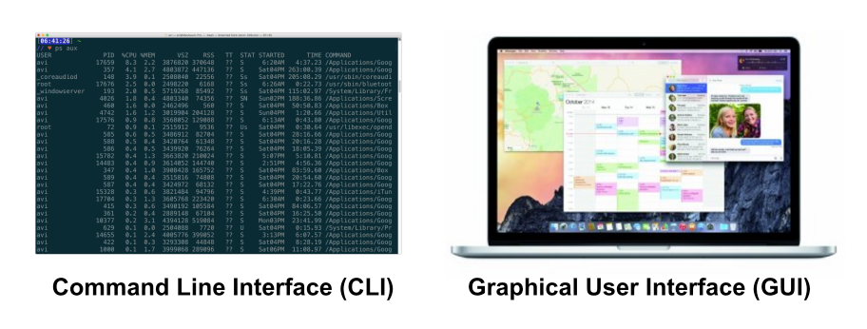
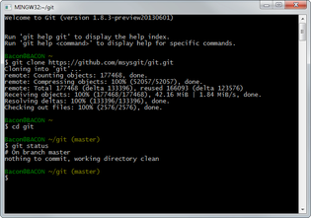
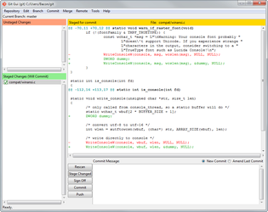
CLI vs. GUI
http://gitx.frim.nl/

Slide 12
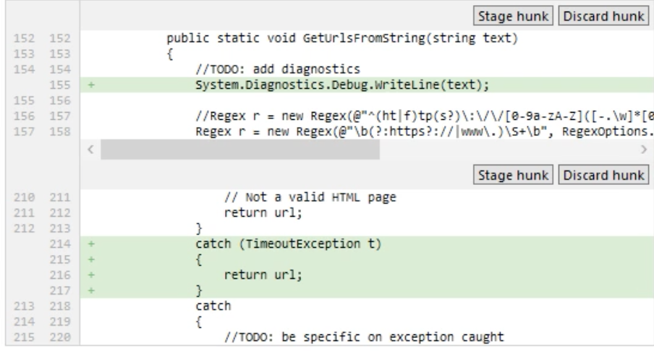
Commit individual hunk
Atlassian SourceTree
Notes:
Here is an example of of a feature available from SourceTree client not as easy with command line clients,
It can be done with a dash i added to commit add, for interactive.
From https://app.pluralsight.com/library/courses/using-git-with-gui/table-of-contents

Slide 13
Basic skills
Decide on GitHub
Enter the GitHub Ecosystem (famous repos)
Make a one-page static website
Install command line client
Install GUI client
Configure Git environment (SSH)
Analyze a repo on GitHub

Slide 14
Git Mastery means...
ACTIVITY
1
Use secure communications and handle secrets securely
Switch among multiple accounts
Install and configure an appropriate Git client
Create and use aliases (keyboard shortcuts)
Automate in scripts (Bash & PowerShell) - securely
Know enterprise team workflow
Know “HEAD” pointers
Can undo from each status
Know statuses of files
2
3
4
5
6
7
8
9
Notes:
The topics we cover today is what almost all tutorials I've seen not cover
Here are the "instructional objectives"
NEXT: What we are NOT covering today is this ...

Slide 15
Daily tasks
Configure repo and workflow on GitHub
Configure a local repo from GitHub
Analyze local repository
Fetch remote changes into local repo
Make changes in a local repo
Remove files
Stash & un-stash tracked files temporarily
Ignore files in repo and globally
Commit changes and amend
Test locally and back-out

Slide 16
Scary-ish tasks
Resolve a conflicting merge condition
Identify differences
Install and try different diff/merge tools
File push request
Clean-up locally
Process GitHub repos automatically
Render Markdown locally
Code Markdown text
Beyond this tutorial
* Sub-modules and sub-trees

Slide 17
GitHub Enterprise
https://enterprise.github.com/home
Launched 2011 for private repos
$250/user/year (less under SAP license)
24/7 support
On-premises OVF under VMware
LDAP/AD integration
Code review features

Slide 18
GitLab Enterprise vs. GitHub Enterprise
https://about.gitlab.com
_
$149/user/year (unlimited private repos)
24/7 support
On-premises on metal (not VMs), clustered
Binary files with GitLab Annex
LDAP/AD integration
Code review with approvals

Slide 19
clone options (SSH)
–t rsa –C"user1@corp.com"
~/.ssh/
Git client
ssh-keygen
private key
id_rsa
id_rsa.pub
PuTTYgen
passphrase
your repo (on
GitHub .com)
clone
via port 80
http://github.com/user1/project.git
clone
via port 22
git@github.com:user1/project.git
clone
ssh:user1@server:project.git
via port 22
SSH Key
clone
git://server/project.git
via port 9418
clone
file://myrepos/project
clone
/myrepos/project
via hard link
~/.ssh/config
Host github.com-user1
HostName github.com
User git
IdentityFile ~/.ssh/id_rsa
Notes:
NOTE: This is described in ACTIVITY 8: Copy repo from GitHub to local git, page 71
A local copy of a repository from github.com or private enterprise repo
can be transferred using the clone command issued from within a executable.
Settings such as the user’s name and email address are specified in configuration commands.
The target URL is typically copied from the github web page.
But the client can also process commands which handle transfers more securely use public and private keys.
The ssh-keygen generates pairs in the .ssh folder in the home folder of the current user.
The command makes pass phrase optional, but we recommend it.
The contents of the public key is pasted in the github web site for use in signing what it sends out, through typically port 443 rather than port 80.
There are other options for cloning that we don’t have time for today.
But remember that one can add the name of a directory folder to create on the local drive.
See LukyBoy’s answer in http://stackoverflow.com/questions/4220416/can-i-specify-multiple-users-for-myself-in-gitconfig
https://orrsella.com/2013/08/10/git-using-different-user-emails-for-different-repositories/

Slide 20
HEAD coding
most recent
git commit –m"Add f"
echo "f money">>file-f.txt
git show --oneline HEAD
git commit -m"Add e"
HEAD^1
echo "test money">>file-e.txt
HEAD~1 =
HEAD^ =
git branch -d feature1
HEAD~2 =
HEAD^^ =
HEAD~1^1
git commit –m "squashed"
~ tilde
parentage
^ caret sequence
git merge –-squash feature1
git checkout master
git commit –m"Add d"
HEAD~2^2
echo "colour">>file-d.txt
HEAD@{5}
git commit –m"Add c"
HEAD~2^3
touch LICENSE.md
git checkout v1 -b feature1
git tag v1
HEAD~3 =
HEAD^^^
HEAD~2^1
git commit –m"Add .gitignore"
echo "secret">>.gitignore
HEAD~4 =
HEAD^^^^
HEAD~3^1
git commit –m"Add README.md"
1st commit
parent
touch README.md
git init
https://github.com/wilsonmar/git-utilities/blob/master/git-sample-repo-create.sh
https://git-scm.com/docs/git-show
Notes:
Changes are shown from the bottom up because that’s how git logs lists changes.
^ caret symbol, ~ tilde symbol
When checkout is done, work is brought along.
http://www.paulboxley.com/blog/2011/06/git-caret-and-tilde
objects are sharded within folders named for the first two characters of objects.

Slide 21
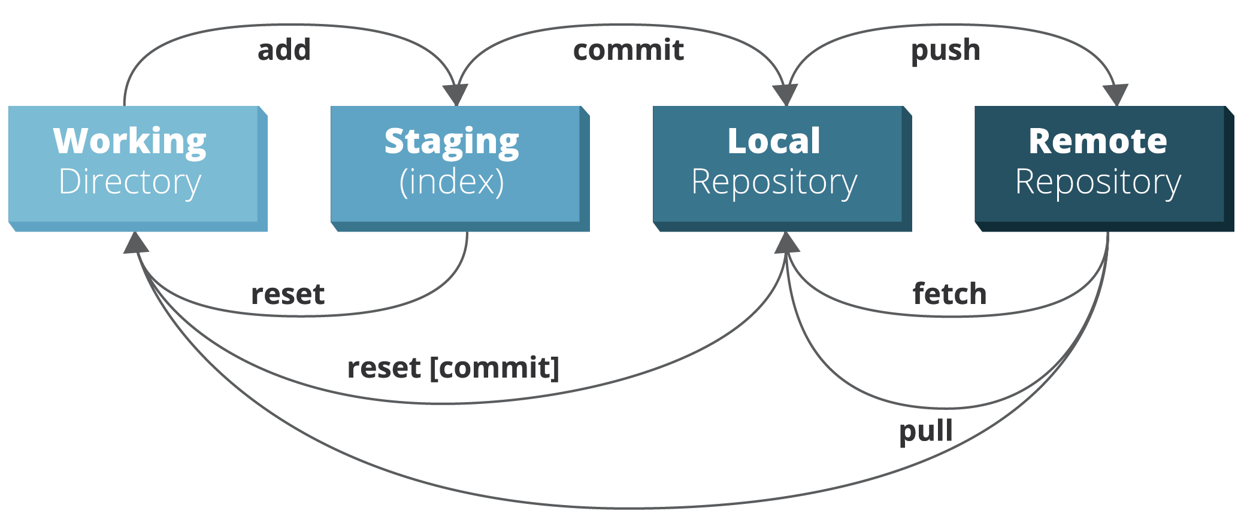
Basic action verbs
http://zeroturnaround.com/rebellabs/git-commands-and-best-practices-cheat-sheet/

Slide 22
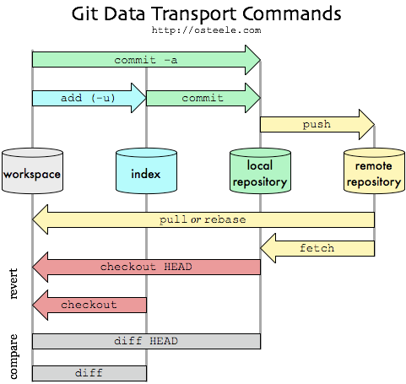
Basic workflows
http://blog.osteele.com/posts/2008/05/my-git-workflow/

Slide 23
Git help
usage: git [--version] [--help] [-C <path>] [-c name=value]
[--exec-path[=<path>]] [--html-path] [--man-path] [--info-path]
[-p | --paginate | --no-pager] [--no-replace-objects] [--bare]
[--git-dir=<path>] [--work-tree=<path>] [--namespace=<name>]
<command> [<args>]
These are common Git commands used in various situations:
start a working area (see also: git help tutorial)
clone Clone a repository into a new directory
init Create an empty Git repository or reinitialize an existing one
work on the current change (see also: git help everyday)
add Add file contents to the index
mv Move or rename a file, a directory, or a symlink
reset Reset current HEAD to the specified state
rm Remove files from the working tree and from the index
examine the history and state (see also: git help revisions)
bisect Use binary search to find the commit that introduced a bug
grep Print lines matching a pattern
log Show commit logs
show Show various types of objects
status Show the working tree status
grow, mark and tweak your common history
branch List, create, or delete branches
checkout Switch branches or restore working tree files
commit Record changes to the repository
diff Show changes between commits, commit and working tree, etc
merge Join two or more development histories together
rebase Reapply commits on top of another base tip
tag Create, list, delete or verify a tag object signed with GPG
collaborate (see also: git help workflows)
fetch Download objects and refs from another repository
pull Fetch from and integrate with another repository or a local branch
push Update remote refs along with associated objects
'git help -a' and 'git help -g' list available subcommands and some
concept guides. See 'git help <command>' or 'git help <concept>'
to read about a specific subcommand or concept.

Slide 24
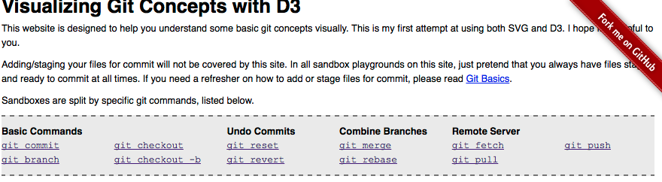
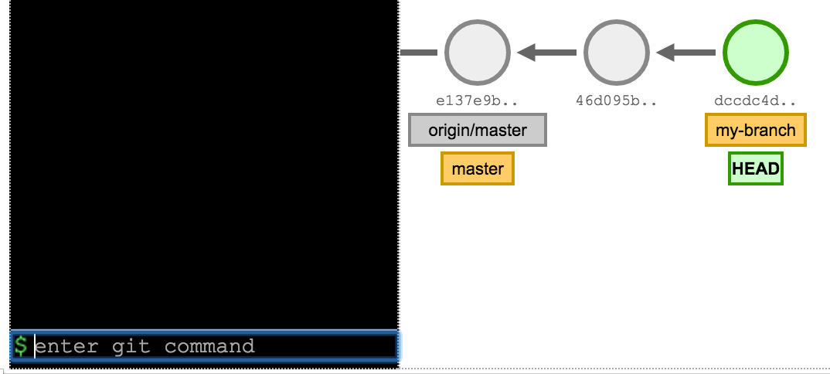
Visualizing Git with D3
http://www.wei-wang.com/ExplainGitWithD3/#
Notes:
This website makes use of the D3 JavaScript library to paint complex visualizations.
Most introductory tutorials focus on around the 10 basic commands.

Slide 25
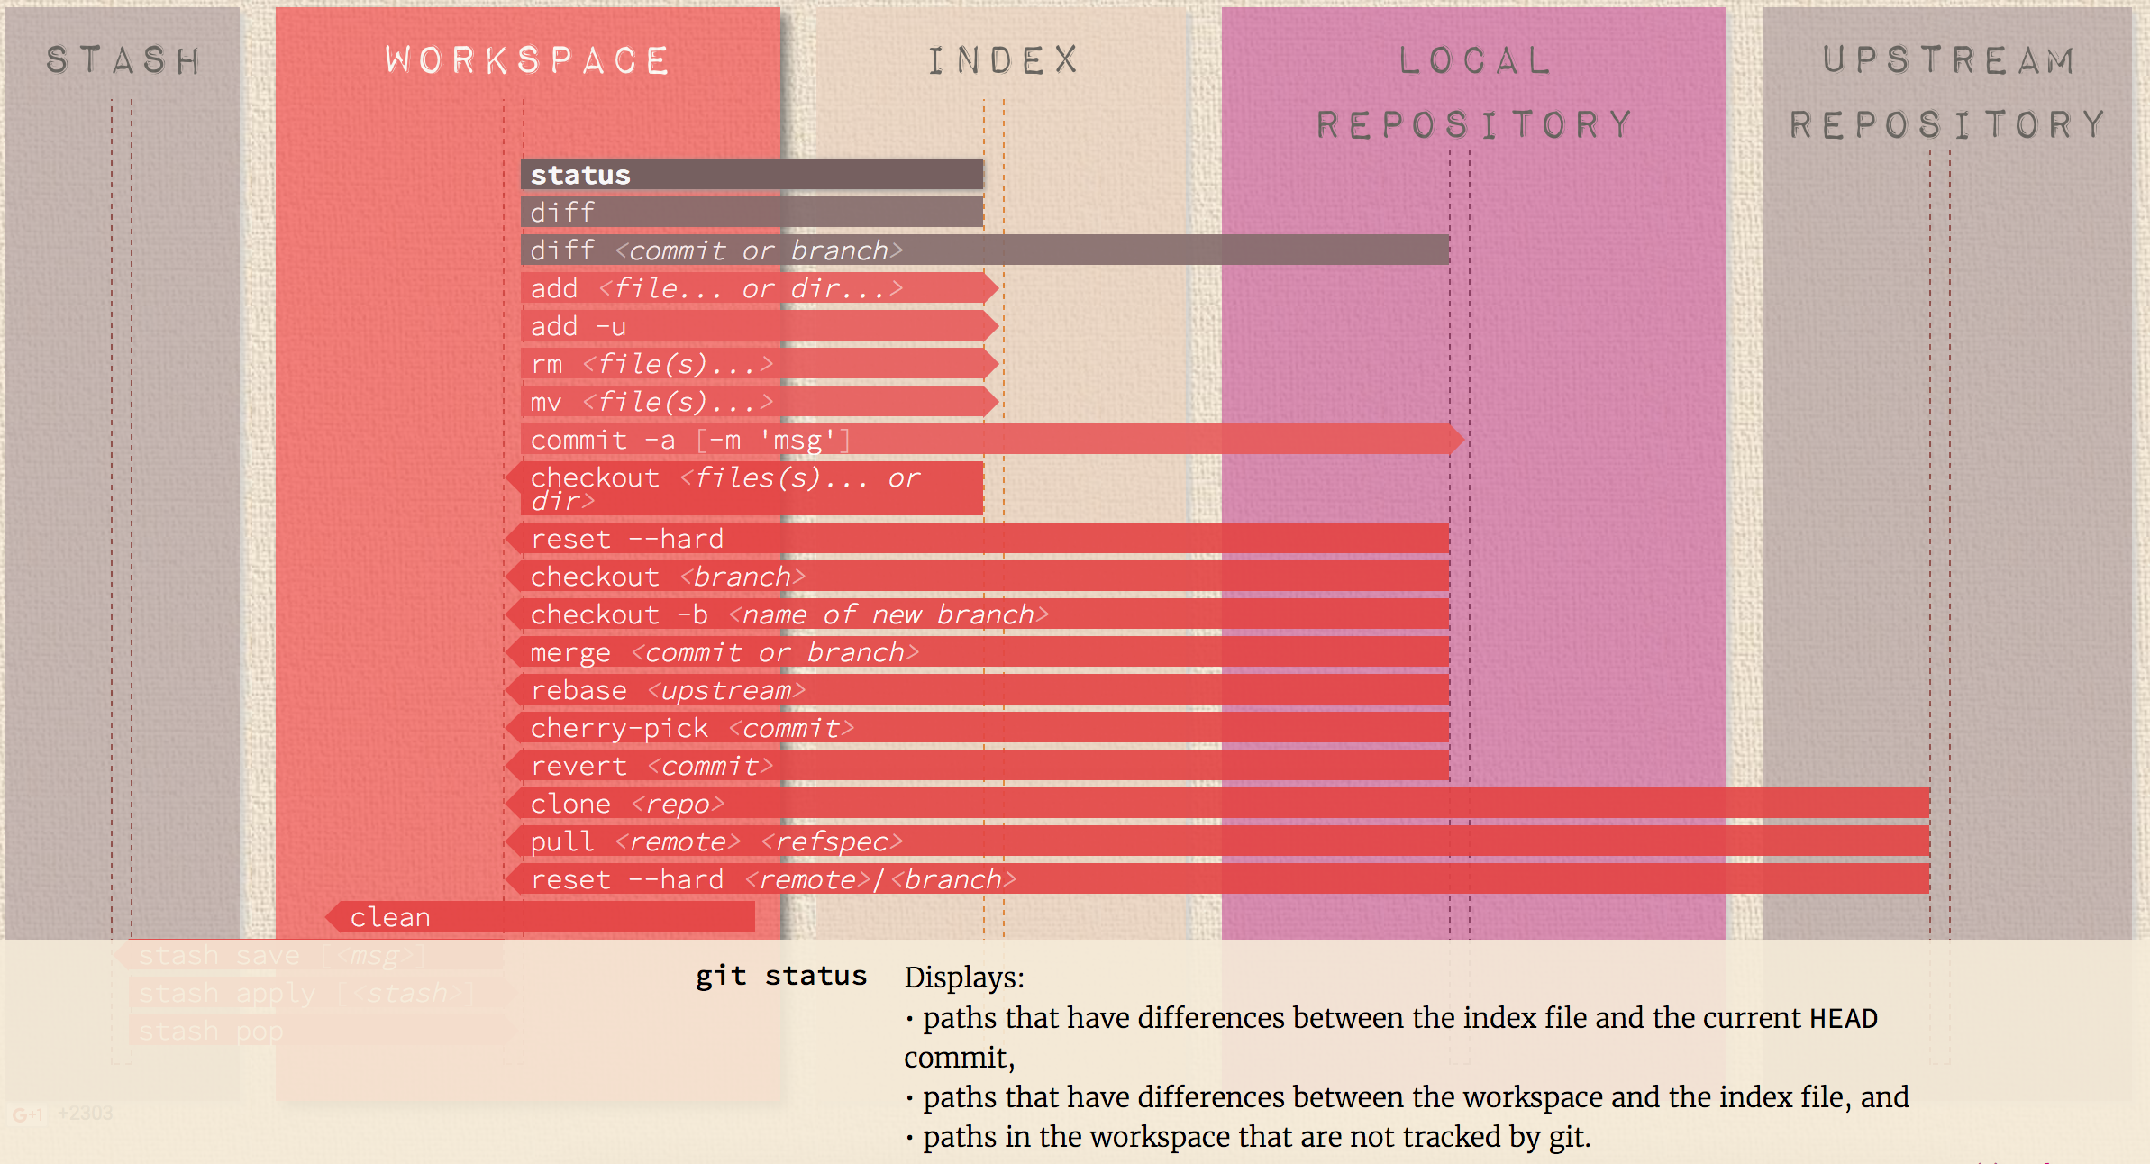
http://ndpsoftware.com/git-cheatsheet.html#loc=workspace

Slide 26
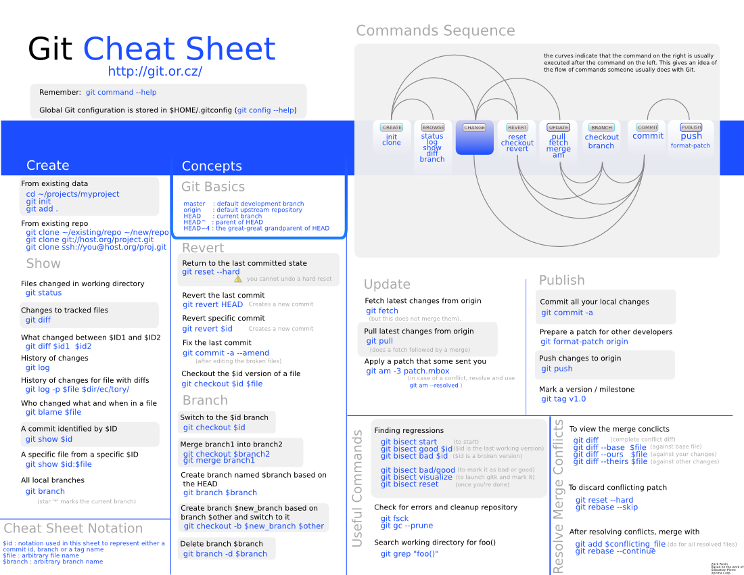
http://byte.kde.org/~zrusin/git/git-cheat-sheet.svg
Notes:
As with Linux commands, git commands have optional arguments

Slide 27
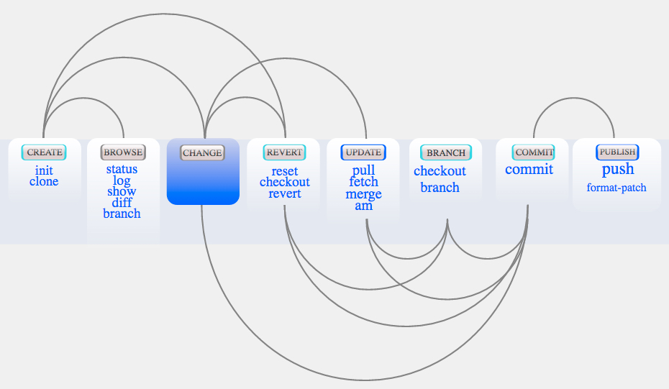
Zink Rusin’s cheat sheet
http://zrusin.blogspot.com/2007/09/git-cheat-sheet.html
Notes:
More advanced tutorials like this covers 20 commands that professional programmers need.
We read this from left to right, starting with init or clone.
What is missing from this?

Slide 28
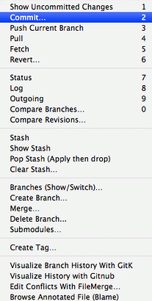
TextMate Git menu
http://gitorious.org/projects/git-tmbundle

Slide 29
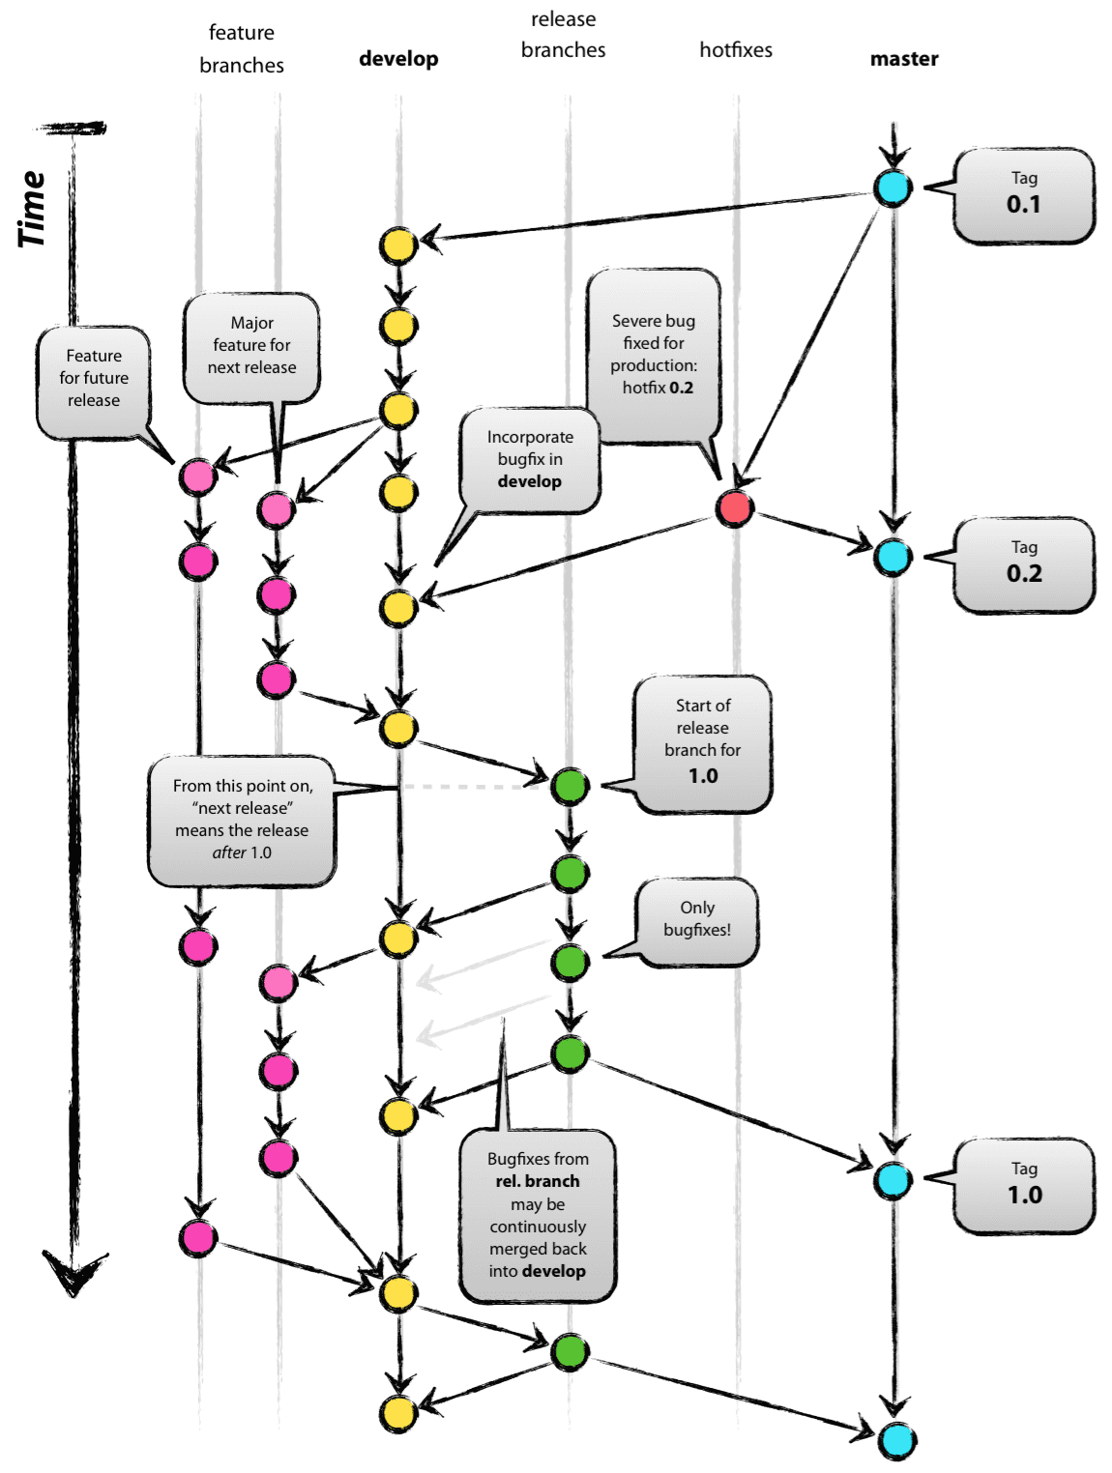
Git Flow workflow (2010)
http://nvie.com/posts/a-successful-git-branching-model/
branches:
feature
develop
release
hotfix
master
support
(local)
qa
Notes:
by Vincent Dressen
The master branch is the production branch.
The release branch provides a stable base for usually automated deploy to production at defined times.
The develop branch are used for automatic nightly integration test builds.
These are all long-running branches that remain on the repository indefinitely.
Hotfix branches are created only when needed to fix production. Having them in a separate branch enables regular work to continue while a hotfix is being developed and tested.
Branch names begin with “hotfix”.
Let’s construct a map of how to visualize how to work locally with your github repos on github.com.
Tracked? Modified?

Slide 30
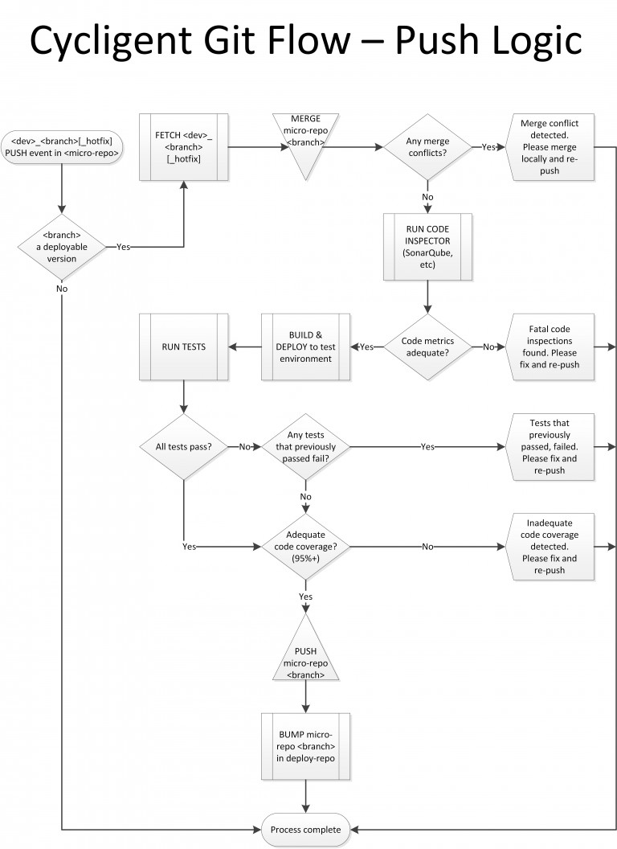
Git flow with tests
1
2
3
4
8
7
5
6
9
10
11
12
13
14
git flow cycligent-768x1056.jpg from https://www.cycligent.com/blog/cycligent-git-flow-intro/
Notes:
This is a great flowchart.

Slide 31
Agile activities
separate
clone or init local repository
Use “develop” branch instead of master
checkout feature branch, story, defect
add to local stage
edit, lint check, unit test hunks
add to staging
commit and commit --amend
run code inspector and code coverage
rebase –i squash (combine commits)
fetch (pull) to update from remote
diff and edit little pieces (test code first?)
merge local master
push feature upstream
review code with others
tag release identifier (with signing)
hooks initiate integration tests
modify
integrate
http://reinh.com/blog/2009/03/02/a-git-workflow-for-agile-teams.html
Notes:
The 3 basic stages of work are first to separate a repo from github, modify it, then integrate changes back in.
The basic objective here is to enable individual developers to operate separately such that a main branch is kept pure and operational all the time while also providing feature branches "room" for developers to make modifications as experiments.
Automated testing at the unit level before uploading to GitHub AND automated invocation of end-to-end testing scripts on the repository shared by everyone is what keeps the system humming.
Source: Josh Susser’s Agile and the Story Branch Pattern
http://reinh.com/blog/2009/03/02/a-git-workflow-for-agile-teams.html
Let’s construct a map of how to visualize how to work locally with your github repos on github.com.
Tracked? Modified?

Slide 32
~/.ssh/config
# git@github.com:user1/project.git
Host github.com-user1
HostName github.com
User git
IdentityFile ~/.ssh/id_rsa
Host gist.github.com
HostName github.com
User git
IdentityFile ~/.ssh/id_rsa
Host github.com-user2
HostName github.com
User git
IdentityFile ~/.ssh/id_rsa_user2
Notes:
From page 45 of the Book v2 by Scott Chacon.

Slide 33
.gitconfig
[push]
default = simple
[user]
name = Wilson Mar
email = wilsonmar@gmail.com
username = wilsonmar
signingkey = 12345678
[core]
excludesfile = /Users/mac/.gitignore_global
[difftool "sourcetree"]
cmd = opendiff \"$LOCAL\" \"$REMOTE\"
path =
[mergetool "sourcetree"]
cmd = /Applications/SourceTree.app/Contents/Resources/opendiff-w.sh \"$LOCAL\" \"$REMOTE\" -ancestor \"$BASE\" -merge \"$MERGED\"
trustExitCode = true
[color]
ui = auto
[alias]
# git la to list aliases:
la = "!git config -l | grep alias | cut -c 7-”
Notes:
From page 45 of the Book v2 by Scott Chacon.

Slide 34
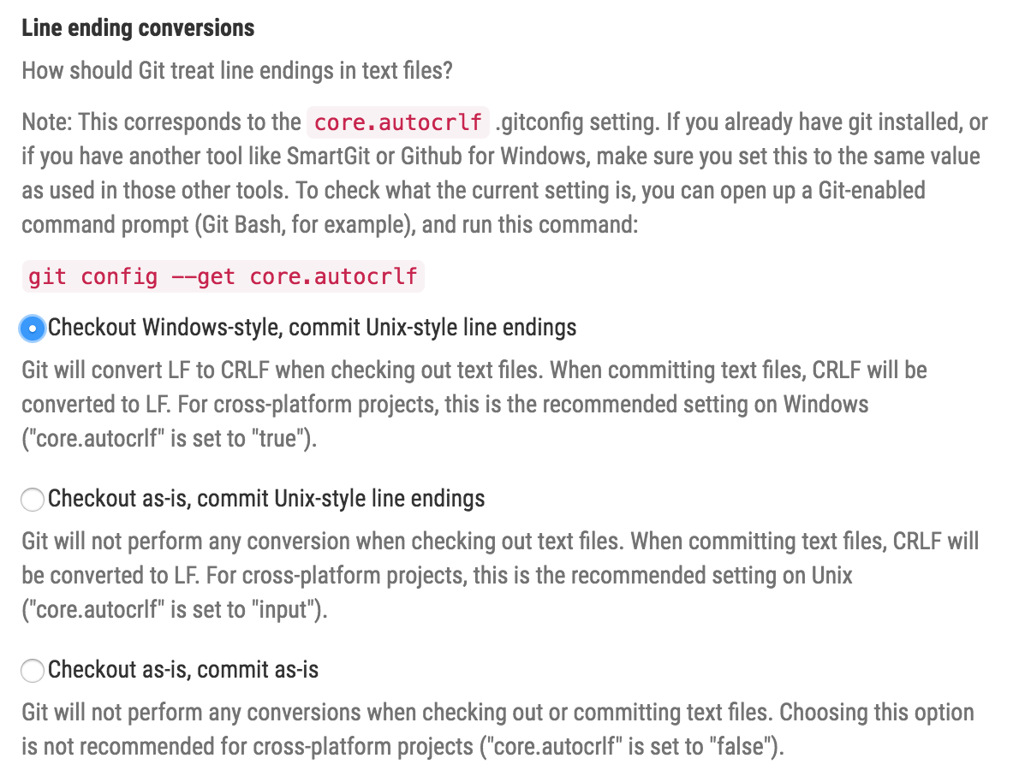
Line ending conversion

Slide 35
Aliases in .gitconfig
[alias]
# list aliases:
la = "!git config -l | grep alias | cut -c 7-"
# rao https://url.git
rao = remote add origin
# branch list sorted by last modified:
b = "!git for-each-ref --sort='-authordate' --format='%(refname) %(objectname:short) %(authordate)%09%09' refs/heads | sed -e 's-refs/heads/--'"
# checkout last branch:
col = "checkout @{-1}"
l = log --pretty='%Cred%h%Creset %C(yellow)%d%Creset %s %Cgreen(%cr)%Creset [%an]' –graph
lg = log --pretty=format:"%C(yellow)%h\\ %ad%Cred%d\\ %Creset%s%Cblue\\ [%cn]" --decorate --date=short
lol = "log --oneline --graph"
s = status –s
g = !gitk --all --date-order &
pu = !"git fetch origin -v; git fetch upstream -v; git merge upstream/master"
# git a "message":
a = !git add . && git commit –am
Notes:
based on https://gist.github.com/mwhite/6887990
https://githowto.com/aliases
git config --global alias.ci commit
http://durdn.com/blog/2012/11/22/must-have-git-aliases-advanced-examples/
http://blogs.atlassian.com/2014/10/advanced-git-aliases/
https://www.youtube.com/watch?v=-kVzV6m5_Qg
https://bitbucket.org/durdn/cfg/src/master/.gitconfig?at=master&fileviewer=file-view-default
https://git.wiki.kernel.org/index.php/Aliases
http://jondavidjohn.com/git-aliases-parameters/

Slide 36
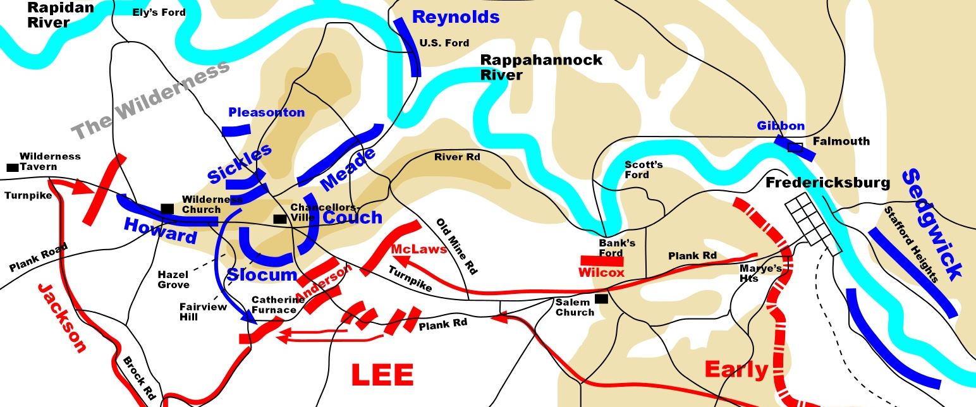

Slide 37
Basic action verbs
http://zeroturnaround.com/rebellabs/git-commands-and-best-practices-cheat-sheet/

Slide 38
Basic workflows
https://github.com/skwp/git-workflows-book

Slide 39
Git battle map
~/.gitconfig
Git client
untracked?
~/.ssh/config, id_rsa_pub
Working directory
tree
modified?
staged?
unmerged?
your repo (on
GitHub .com)
local .git
staging / index
/ cache
.gitignore
merge
stash
GitHub repo
deleted?
git-commands-v05.pptx @Copyright Wilson Mar 2016. All rights reserved.
https://goo.gl/12C1BF
Notes:
Activity 13.

Slide 40
Git command map
~/.gitconfig
Git client
untracked?
status -v
~/.ssh/config, id_rsa_pub
cloud
Working directory
tree
modified?
staged?
unmerged?
config
your repo (on
GitHub .com)
mkdir
gitk
cd
grep
edit
rebase -i
commit -m
local .git
clone
shortlog
init
ls -al
add . –A -p
staging / index
/ cache
--amend
log (lol)
dir
-a
clean -
tag
push --force
echo
revert
reflog
push -u
touch
reset –-hard HEAD
origin
reset HEAD -- <file>
fsck
.gitignore
master
branches
difftool
merge
gc --prune
mergetool
show
fetch
develop
diff v1 v2
diff-tree
blame
pull
Edit
merge
stash pop
stash save
branch -avv
remote -v
Pull
stash apply
stash list
Request
Fork
stash
stash show
stash drop
remote add
GitHub repo
rm
checkout
commit -- file
upstream
rm -rf
deleted?
checkout –b branch
download & unzip
git-commands-v06.pptx @Copyright Wilson Mar 2015-2016. All rights reserved.
https://goo.gl/12C1BF
Notes:
Activity 13.

Slide 41
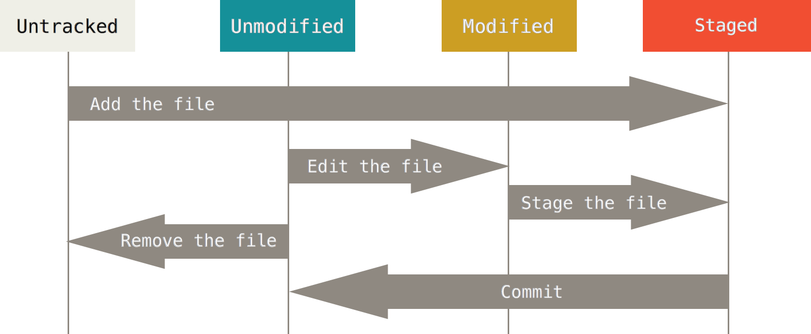
Status
http://git-scm.com/book/en/v2/Git-Basics-Recording-Changes-to-the-Repository#Removing-Files
Notes:
From page 45 of the Book v2 by Scott Chacon.

Slide 42
Feature branch
local git
GitHub / cloud
branches:
feature
develop
develop
canary
master
(topic)
(local)
(qa)
(staging)
(prod)
PR or push
merge
tag
tag
rebase
6
6
6
6
6
resolved
5
merge
hook
log
fetch
diff
4
4
4
4
4
conflict!
pull
after test
3
after fix
2
@Copyright 2016.
Wilson Mar.
All rights reserved.
1
git
checkout
--branch
feature
1
git
clone
repo.git
1
1
1
parallel work
encapsulated
Notes:
See Activity 12.
Source: Josh Susser’s Agile and the Story Branch Pattern
http://reinh.com/blog/2009/03/02/a-git-workflow-for-agile-teams.html
Let’s construct a map of how to visualize how to work locally with your github repos on github.com.
This illustrates the interaction between local and GitHub website.
In many shops, the master branch is not updated manually but only automatically by a script after all tests in staging report success.
Assets in the release branch are updated after run tests run clean against the develop branch.
Those tests would ensure integration correctness by end-to-end test scripts and team walkthroughs.
So most developers only interact with the develop branch.
So when we clone a repo locally, we usually include a branch specification.
Each clone includes an entire copy of the repo, including all its history.
Each branch contains a set of commits, shown here with the oldest a the bottom and most recent at the top.
Only the first 3 characters of the hash for each commit is shown. usually shows the first 7 characters.
If we are to make a change, it’s best to create a new branch as a container for changes to several files made together.
The first change we make is add a new file, and commit it. But we don’t push it up yet because we’re not done with the package.
That evening, someone else committed a change in the repo.
In the morning we do a fetch and see it on our machine.
We make another change (mi3) locally and commit it locally.
When we do a fetch at noon, we realize someone else changed the same file and same line.
So we need to see what the diff is, then merge that with my changes.
Once we have resolved differences, we can merge again.
When we push into GitHub, everyone else will be able to review it and use it.
Kangax.hithub.io/compat-table/es6

Slide 43
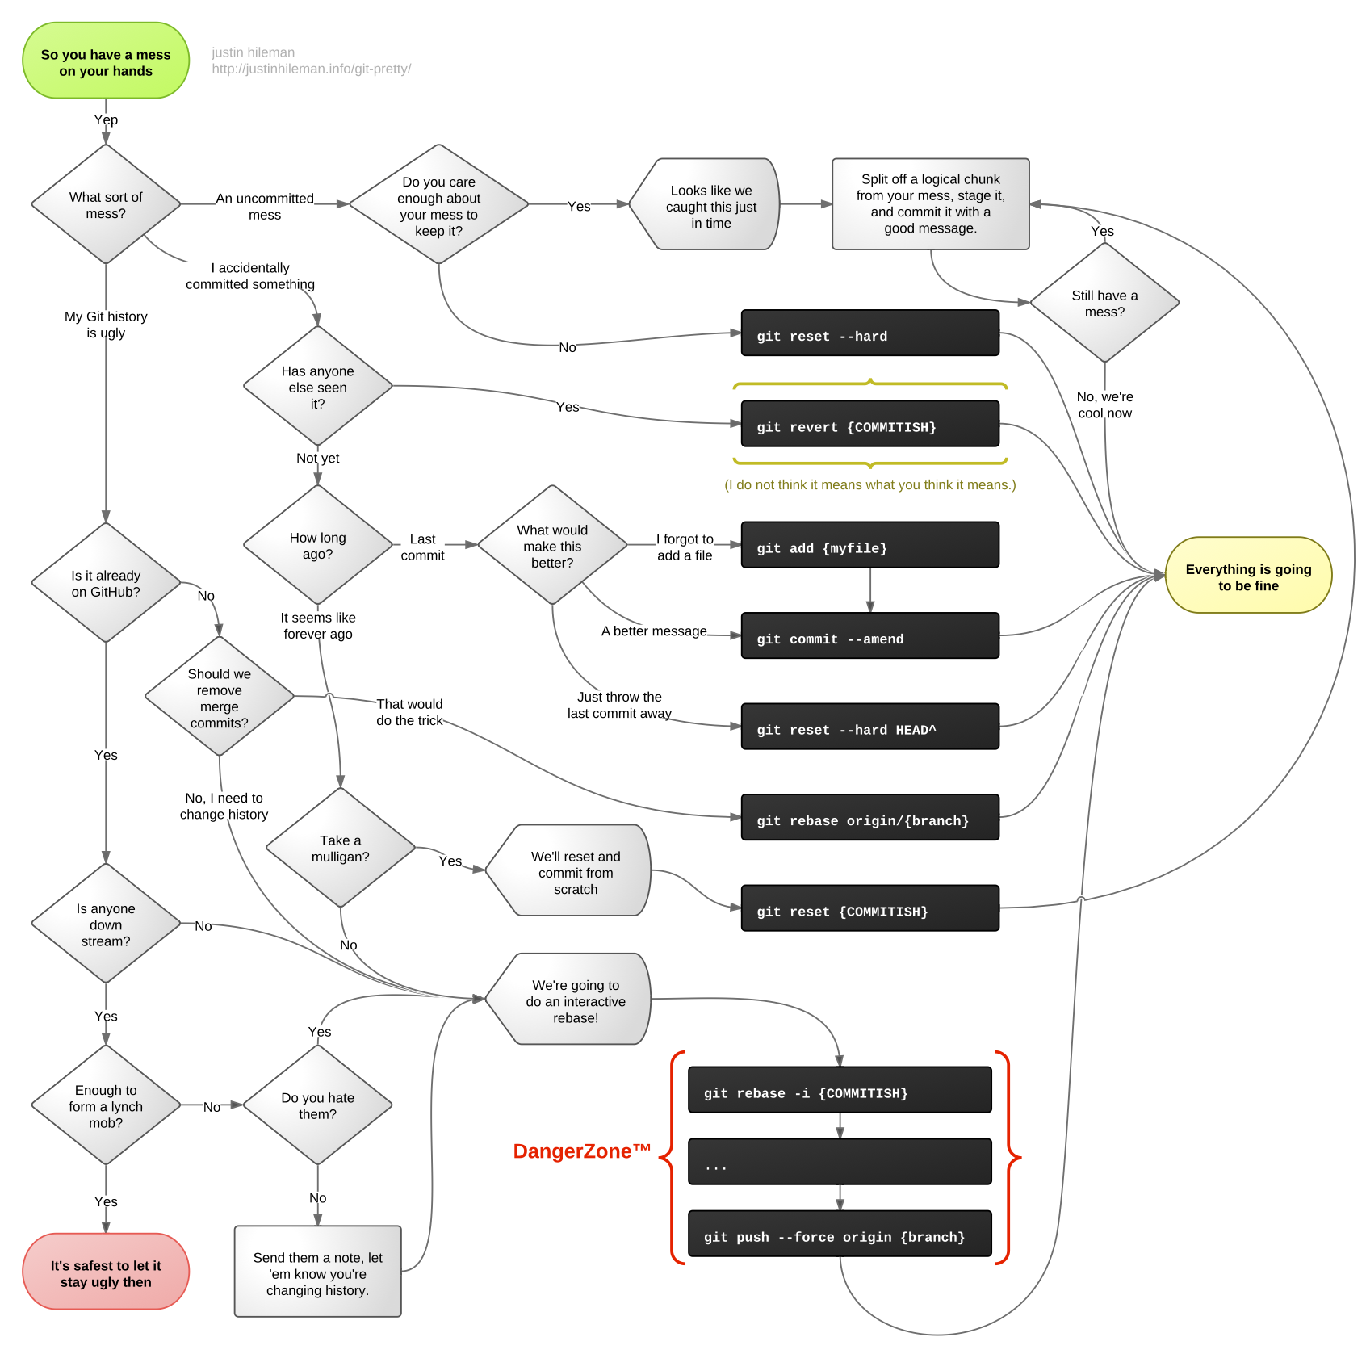
Escape a Git mess
git-pretty-justinhileman.info.png from http://justinhileman.info/article/git-pretty/git-pretty.png
http://www.programblings.com/2008/06/07/the-illustrated-guide-to-recovering-lost-commits-with-git/
Notes:
This is a great flowchart.

Slide 44
QUIZ: Commit or not?
Does git commit create a commit?
Does git tag create a commit?
Does git checkout new branch create a commit?
Does git merge create a commit?
Does git revert create a commit?
Yes. That’s its job.
No if referencing a specific commit. Yes if –a is used.
No. It creates files in working directory from a commit.
No if fast-forward. Yes if not.
Yes. To “undo” previous commit(s) by an opposite commit.
Notes:
If you’re unsure any of these, let’s verify by creating a repository, next.

Slide 45
Search in commit names
Search through commit text matching a regex pattern:
git lol --all --grep='colou?r' -i
--all
= Search in all branches
-g
--walk-reflogs
= Search in reflogs
-v
--invert-match
= reverse match (items NOT containing)
-i
= insensitive cate
http://stackoverflow.com/questions/9045435/search-git-commits-using-regex
http://stackoverflow.com/questions/7124914/how-to-search-a-git-repository-by-commit-message/7124949#7124949
Notes:
http://www.cyberciti.biz/faq/grep-regular-expressions/
Linux comes with GNU grep, which supports extended regular expressions.
http://www.cyberciti.biz/faq/grep-regular-expressions/

Slide 46
Git Diff
--color-words
= color words that are different
--word-diff
= mark text that are different
--stat
= show file names only
http://gitorious.org/projects/git-diff

Slide 47
Git log
--pretty-oneline
= color words that are different
--abbrev-commit
= mark text that are different
--branches=*
= show file names only
--graph
= show file names only
--decorate
= show file names only
git log --pretty=oneline --abbrev-commit --branches=* --graph --decorate
http://gitorious.org/projects/git-log

Slide 48
Git clean
--color-words
= color words that are different
--word-diff
= mark text that are different
--stat
= show file names only
http://gitorious.org/projects/git-clean

Slide 49
Git grep options
identify files containing text which match a specification.
git grep [-a | --text] [-I] [--textconv] [-i | --ignore-case] [-w | --word-regexp]
[-v | --invert-match] [-h|-H] [--full-name]
[-E | --extended-regexp] [-G | --basic-regexp]
[-P | --perl-regexp]
[-F | --fixed-strings] [-n | --line-number]
[-l | --files-with-matches] [-L | --files-without-match]
[(-O | --open-files-in-pager) [<pager>]]
[-z | --null]
[-c | --count] [--all-match] [-q | --quiet]
[--max-depth <depth>]
[--color[=<when>] | --no-color]
[--break] [--heading] [-p | --show-function]
[-A <post-context>] [-B <pre-context>] [-C <context>]
[-W | --function-context]
[--threads <num>]
[-f <file>] [-e] <pattern>
[--and|--or|--not|(|)|-e <pattern>…​]
[ [--[no-]exclude-standard] [--cached | --no-index | --untracked] | <tree>…​]
[--] [<pathspec>…​]
https://git-scm.com/docs/git-grep
Notes:
This utility has a rich set of options adopted from the Linux operating system command of the same name.
Let's see about making these useful.
There are several flags that are similar to other git commands.
Some

Slide 50
Grep contents
Find content of commits matching a pattern:
git grep 'car' $(git rev-list --all)
http://stackoverflow.com/questions/7124914/how-to-search-a-git-repository-by-commit-message/7124949#7124949
Notes:
http://travisjeffery.com/b/2012/02/search-a-git-repo-like-a-ninja/
https://searchcode.com/codesearch/view/86360256/

Slide 51
Grep output count
count tracked files containing text which match a specification.
git grep -c –i "Money"
-c
--count
= count lines instead of showing them
-i
--ignore-case
= ignore upper or lower case
_posts/2016-03-22-manipulate-images-on-mac.md:1
_posts/2016-04-29-api-management-evaluation.md:2
-q
--quiet
= instead of text, output "0" (zero) status if matched
https://git-scm.com/book/en/v2/Git-Tools-Searching
Notes:
http://travisjeffery.com/b/2012/02/search-a-git-repo-like-a-ninja/
https://searchcode.com/codesearch/view/86360256/

Slide 52
Grep output lines
git config --global alias.g "-c color.grep.linenumber=\"bold yellow\" \
-c color.grep.filename=\"bold green\" \
-c color.grep.match=\"reverse yellow\" \
grep --break --heading –n"
git gl "Money"
--break
= print empty line between matches
--heading
= print filename above matches
CONFIGURATION FILE
--line-number
grep.lineNumber = true
-n
= prefix matches
git config --global grep.lineNumber true
_posts/2016-03-22-manipulate-images-on-mac.md
21:is the choice of professionals, and premium features means money.
http://stackoverflow.com/questions/39581198/how-do-you-make-git-grep-output-look-like-ack-output
Notes:
This is more like the "awk" utility output.
http://travisjeffery.com/b/2012/02/search-a-git-repo-like-a-ninja/
https://searchcode.com/codesearch/view/86360256/

Slide 53

Grep target
List files only in Staging containing text which match a specification
git gl –-cached -i "Money"
.gitignore
--untracked (also)
(default
tracked)
--no-exclude-standard (ignore .gitignore)
--cached
(instead)
--no-index (not managed)
--exclude-standard (ignore .gitignore)
ls-files
https://git-scm.com/docs/git-grep
Notes:
git grep defaults to searching in the files that are tracked by git,
whereas the Linux grep version searches everything in the directory.
http://stackoverflow.com/questions/17557684/is-it-better-to-use-git-grep-than-plain-grep-if-we-want-to-search-in-versioned-s

Slide 54
Grep output in context
git grep –W –i "money"
-W
--function-context
= print text surrounding items matched
_posts/2016-03-22-manipulate-images-on-mac.md-## Photo editing programs #
_posts/2016-03-22-manipulate-images-on-mac.md-
_posts/2016-03-22-manipulate-images-on-mac.md-Adobe Photoshop
_posts/2016-03-22-manipulate-images-on-mac.md:is the choice of professionals, and premium features means money.
https://git-scm.com/book/en/v2/Git-Tools-Searching
Notes:
The brackets are commonly used to indicate options.
http://travisjeffery.com/b/2012/02/search-a-git-repo-like-a-ninja/
https://searchcode.com/codesearch/view/86360256/

Slide 55
Grep output lines
git config --global alias.gv "grep –C 3 -A 3 –B 3 -W"
??
git grep gv "money"
-B
--before-context #
= print # of leading lines with -- divider
-A
--after-context #
= print # of trailing lines with -- divider
-C
--context #
= print # of leading & trailing lines with --
-P
--show-function
= print preceding line (like git diff)
-W
--function-context
= print text surrounding item found
https://git-scm.com/book/en/v2/Git-Tools-Searching
Notes:
http://travisjeffery.com/b/2012/02/search-a-git-repo-like-a-ninja/
https://searchcode.com/codesearch/view/86360256/

Slide 56
Grep regular expressions
git grep –- "colou?r"
CONFIGURATION FILE
-F
--fixed-strings
grep.patternType = fixed
-B
--basic-regexp
grep.patternType = basic
-E
--extended-regexp
grep.patternType = extended
-P
--perl-regexp
grep.patternType = perl
git config --global grep.extendRegexp true
-v
--invert-match
= reverse match (items NOT containing)
http://stackoverflow.com/questions/9045435/search-git-commits-using-regex
https://git-scm.com/docs/git-grep
Notes:
http://www.cyberciti.biz/faq/grep-regular-expressions/
Linux comes with GNU grep, which supports extended regular expressions.
http://www.cyberciti.biz/faq/grep-regular-expressions/

Slide 57
Grep
git <command> [<revision>...] -- [<file>...]
??
git grep -e money -–or foo
git grep -c money
PROTIP: Quotes are needed only if spaces are in search term.
-e
separate word
-w
separate word
-i
upper or lower case
-x
remove all untracked files
-X
remove only files ignored by Git
~/.gitignore
https://git-scm.com/book/en/v2/Git-Tools-Searching

Slide 58
Grep limits
identify files containing text which match a specification.
git grep options -- limiters
git gl -i "foo" –- '*.rb'
--max-depth -1
= no limit to levels of directory to descend
--max-depth 2
= descend into at most 2 directory levels
(ignored if file wildcards are specified)
[ -l | -L | --name-only |
--files-with-matches ]
= list files only
https://git-scm.com/docs/git-grep
Notes:
CAUTION: Don't confuse the double-dash in front of options with the double-dash separator between options and the path specification.

Slide 59
Grep match text
identify files containing text which match a specification.
git grep –l foo
[ -a | --text ]
= process binary files as if they were text
https://git-scm.com/docs/git-grep
Notes:
Square brackets are used to show options that do the same thing.

Slide 60
Grep target format
identify files containing text which match a specification.
git grep options
-w
separate word
-i
upper or lower case
[ -a | --text ]
= process binary files as if they were text
-I
= don't match pattern in binary files
https://git-scm.com/docs/git-grep
Notes:
Square brackets are used to show options that do the same thing.

Slide 61
Clean Working Tree
clean working tree by removing files untracked by version control
git clean –di -n
-d
directories (in addition to files)
-i
interactive (select one file at a time)
-n
dry run
-q
quiet (only report errors)
-x
remove all untracked files
-X
remove only files ignored by Git
.gitignore
PROTIP: Put –n at the end so it can be removed by backspace.
https://git-scm.com/docs/git-clean
Notes:
From page 45 of the Book v2 by Scott Chacon.

Slide 62
Git ignore
list files being ignored
git ls-files –-others –ignored –exclude-standard
gitk -–all `git reflog | cut –c1-7`&
https://git-scm.com/docs/git-grep

Slide 63
Internals
|-- index
|-- info
| `-- exclude
|-- logs
| |-- HEAD
| `-- refs
| |-- heads
| | `-- master
| `-- remotes
| `-- origin
| `-- master
|-- objects
| |-- 00
| | |-- 0845179832190a64352439f621bb797d05f826
| |-- 01
| | |-- 17df35ff39701b1d10f996160b90c8b2b5d753
|-- packed-refs
`-- refs
|-- heads
| `-- master
|-- remotes
| `-- origin
| `-- HEAD
`-- tags
= (40 hex digits)
git rev-parse 0117
git cat-file –p 0117df

Slide 64
Recover dangling blobs
Check object database for "dangling blobs" and commits:
git fsck
Iterate through dangling blobs to recover them as files named after their hashes:
for blob in $(git fsck --lost-found | awk '$2 == "blob" { print $3 }'); do git cat-file -p $blob > $blob.txt; done
http://blog.ch.atosconsulting.com/git-recovering-from-mistakes/

Slide 65
QUIZ: multiple choice
Does GitHub have a limit on file size?
Does Git have a limit on repo size?
What happens when a repo goes beyond that limit?
Yes. 100 MB. 25 MB if added in a browser.
Yes. 1 GB.
GitHub sends you an email is sent.
(So make GitHub an approved email, not spam).
https://help.github.com/articles/what-is-my-disk-quota/
Notes:
http://www.thereformat.com/git_qz (10 questions with answers)
http://genecats.cse.ucsc.edu/eng/gitQuiz.txt – 24 questions with answers
https://niksilver.com/2013/08/20/git-quiz/ -
https://learn.co/lessons/git-github-learn-quiz

Slide 66
Github Flavored Markdown
# Heading 1 #
## Heading 1.1 #
0. List 1
* [Internal](Heading 1.1)
* <a target=“_blank” href=“#Heading1.1”>Internal</a>
```
init
```
| header1 | numbers |
| ------- | ------: |
| text 1 | 12.12 |
3 spaces before ``` to indent

Slide 67
browser
browser
stackedit.io
dillenger.io
Users:
local
browser
Haroopad,
mou.io, etc.
HTML+
iOS
kindle
Copyright 2016 by Wilson Mar
All rights reserved.
raw
API
CDN
offline
github.com
git
editor
AZW
acct/repo
acct/acct.github.io
mobi
pdf
markdown& code
gh-pages br.
ePub
markdown
markdown
render
Python
Ruby
Jekyll+ Kramdown Liquid
grip
Jekyll+
API
gitbook.io,
leanpub.com, EC2, etc.
ghw
acct.github.io
HTML+
CI/CD
_site
wiki
markdown
HTML+
HTML+
HTML+
/x
Dropbox
FTP
https://goo.gl/12C1BF

Slide 68
https://groups.google.com/forum/#!forum/git-users
by @WilsonMar
Skype: wilsonmar4
https://wilsonmar.github.io

